Slide 1
Analyzing Healthcare Trends
Group 1 Team Members: Brianna Bethea,Kavita Gopal, Laquita Palmer, Derek Hill

Slide 2
Project Proposal: Introduction
Introduction- Understanding health trends is essential for identifying emerging health issues, shaping public health policies, and enhancing healthcare services. This project aims to analyze key health trends by examining prevalent medical conditions, lifestyle factors, and demographic influences. The objective is to uncover patterns and correlations that can provide actionable insights for stakeholders.Our team, consisting of Brianna, Derek, Kavita, and Laquita, has conducted an in-depth analysis using the healthcare dataset from the "Unlocking Healthcare Trends: Data Analysis" project authored by Muhammad Furqan. The dataset, sourced from Kaggle, contains 10,000 synthetic patient records, which include a wide range of attributes such as patient demographics, medical conditions, and admission details. The data is entirely synthetic and is intended for educational and non-commercial use.The analysis was conducted using Python, along with libraries such as Pandas and Matplotlib, to perform data cleaning, analysis, and visualizations. These tools enabled us to explore the relationships among various variables in the dataset and draw meaningful conclusions.

Slide 3
Project Proposal: Data Sources & Objectives
Primary Dataset: Kaggle Health Dataset (health_dataset.csv)
The objectives of this project are as follows:
Analyze Gender-Based Susceptibility to Medical Conditions:
Identify the prevalence of medical conditions among male and female populations within the dataset.
Determine which gender is more susceptible to specific medical conditions.
Evaluate Billing Amounts for One-Day Hospital Stays:
Use statistical analysis to determine the highest billing amounts for various medical conditions during a one-day hospital stay.
Examine Insurance Provider Coverage:
Identify the most prevalent medical conditions covered by different insurance providers.
Compare the average billing amounts associated with each medical condition by insurance provider.
Analyze Hospital Admission Types by Age Group:
Compare the frequency of different hospital admission types (Elective, Emergency, Urgent) across various age groups.
Determine the Most Commonly Admitted Conditions:
Identify the medical condition with the highest admission rates and the corresponding insurance provider with the highest admission frequency.

Slide 4
Project Proposal: Methodology
Methodology
Data Collection:
Extract relevant data from the dataset, focusing on health conditions, billing information, insurance providers, duration of hospital stays, and admission types.
Data Cleaning and Preparation:
Clean and wrangle the data to address missing values, outliers, and inconsistencies.
Merge datasets as needed to create a comprehensive dataset for analysis.
Exploratory Data Analysis (EDA):
Conduct EDA to understand data distribution and identify patterns or trends.
Generate summary statistics for each variable to provide a foundational understanding of the dataset.
Visualization:
Create various visualizations, such as bar charts, heatmaps, pie charts, and bell curves, to illustrate the trends and correlations in the data.
Utilize these visualizations to present findings in a clear and comprehensible manner.
Interpretation and Recommendations:
Interpret the results of the analysis to draw conclusions about the health trends identified.
Provide recommendations based on these findings to inform healthcare policies and practices.

Slide 5
Project Proposal: Conclusions
Insurance Provider and Medical Condition Correlation:
Conclusion: Arthritis and Asthma are most commonly associated with Cigna, Cancer and Hypertension with United Healthcare, Diabetes with Medicare, and Obesity with Blue Cross.
Admission Types by Generation:
Conclusion: Generation X has the highest rates of Elective and Urgent admission types, while Seniors exhibit the highest rates of Emergency admissions.
Billing Amounts for One-Day Hospital Stays:
Conclusion: Hypertension incurs the highest average billing cost for a one-day hospital stay, with significant variance in billing amounts as depicted by a bell curve.
Gender-Based Prevalence of Medical Conditions:
Conclusion: Females show a higher prevalence of Arthritis, Diabetes, and Hypertension, with Obesity reaching 100%. Males are more prone to Asthma, Cancer, Diabetes, Arthritis, and Hypertension. Hypertension is equally distributed among both genders.
Trends in Admissions Over Time:
Conclusion: There was a steady increase in admissions into 2020, followed by a decline to regular admission numbers later. Additionally, older age is correlated with a higher prevalence of health conditions.

Slide 6
Team Member: Brianna Bethea
Focus: Medical Conditions/Insurance Providers; Admission Type/ Age
Objective:
To identify the most prevalent medical conditions covered by different insurance providers.
To compare the frequency of different hospital admission types (Elective, Emergency, Urgent) among various age groups.
Conclusions:
Arthritis & Asthma are most associated with Cigna, Cancer & Hypertension with United Healthcare, Diabetes with Medicare, and Obesity with Blue Cross.
Gen X has the highest Elective and Urgent admission types, while Seniors have the highest Emergency admission type.

Slide 7
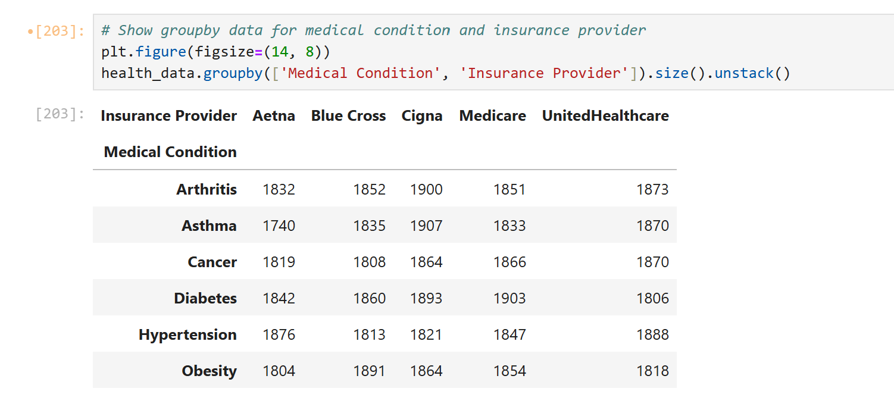
Groupby Dataset: Medical Condition & Insurance Provider

Slide 8
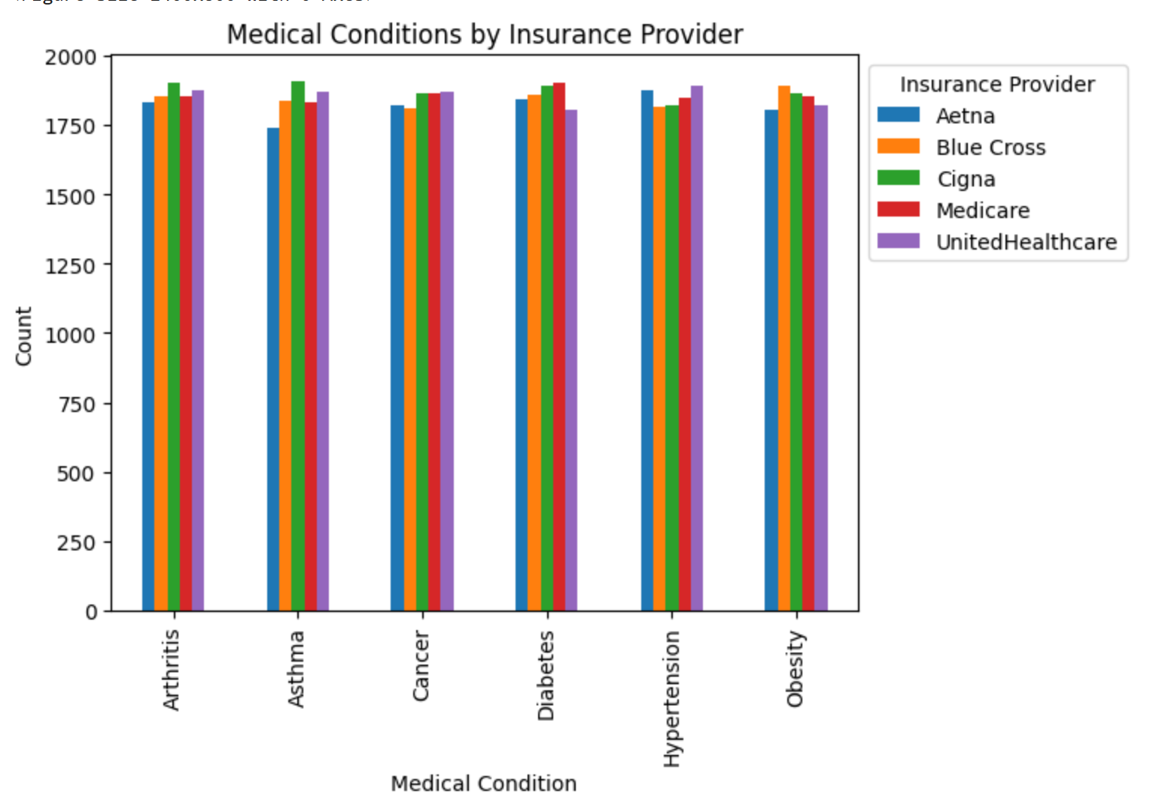
Chart 1: Medical Conditions by Insurance Providers

Slide 9
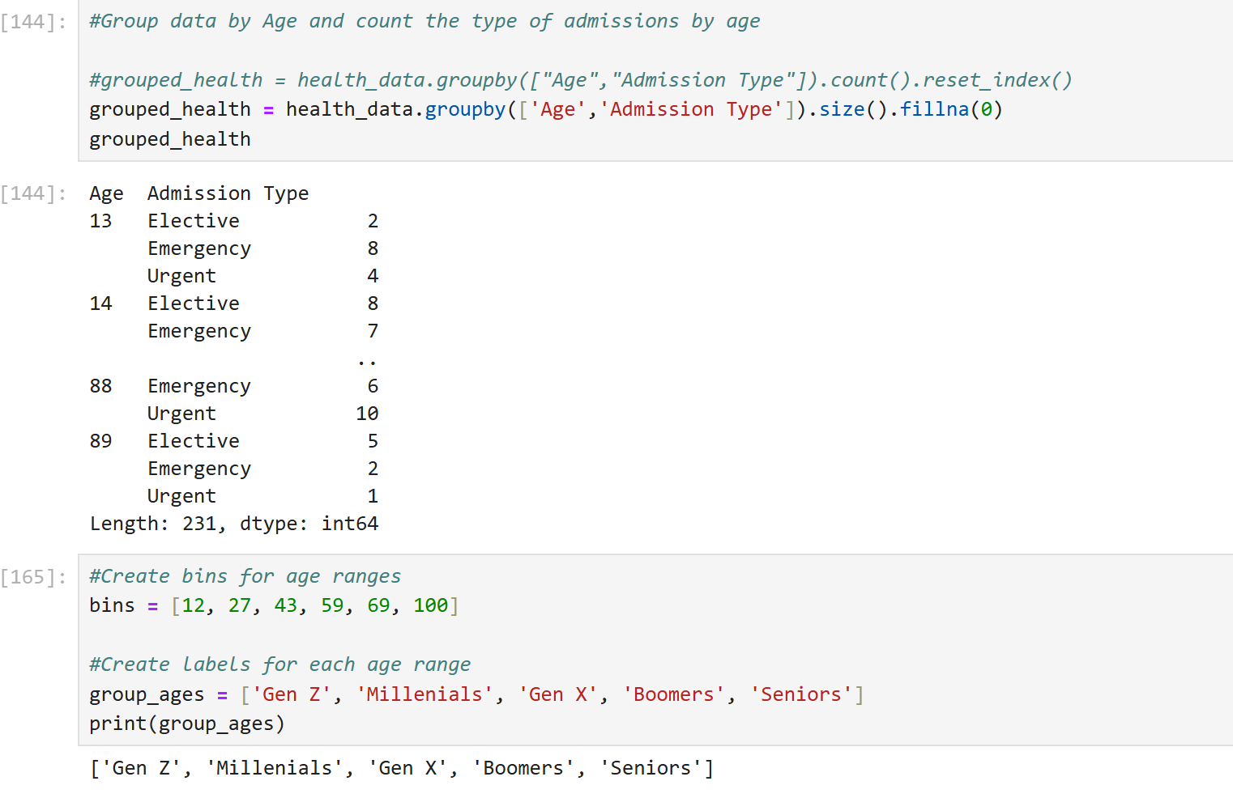
Notes:
Groupby Dataset: Admission Type & Age

Slide 10
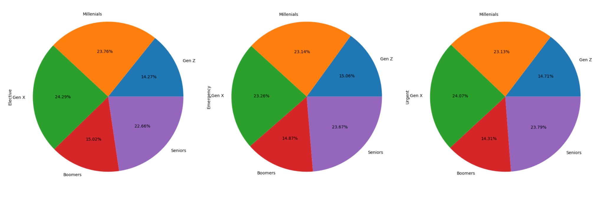
Chart 2: Hospital Admission Type Across Generations

Slide 11
Kavita Gopal
Find the contents of the dataset
Cleaning up the dataset, to get a clearer idea, to enable suitable analysis & conclusion
Aim was to combine cost of hospitalization-duration, with the treatment of the specific medical condition
Aim to get some data on gender-prone to diseases within the dataset.

Slide 12
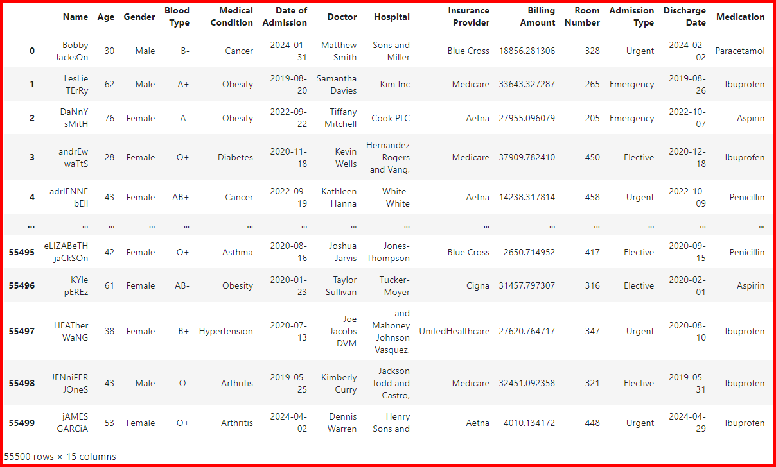
healthcare_df

Slide 13
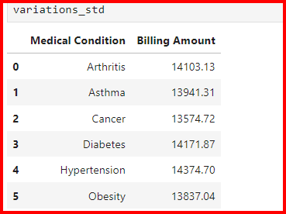
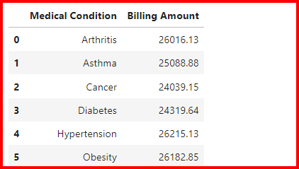

Slide 14
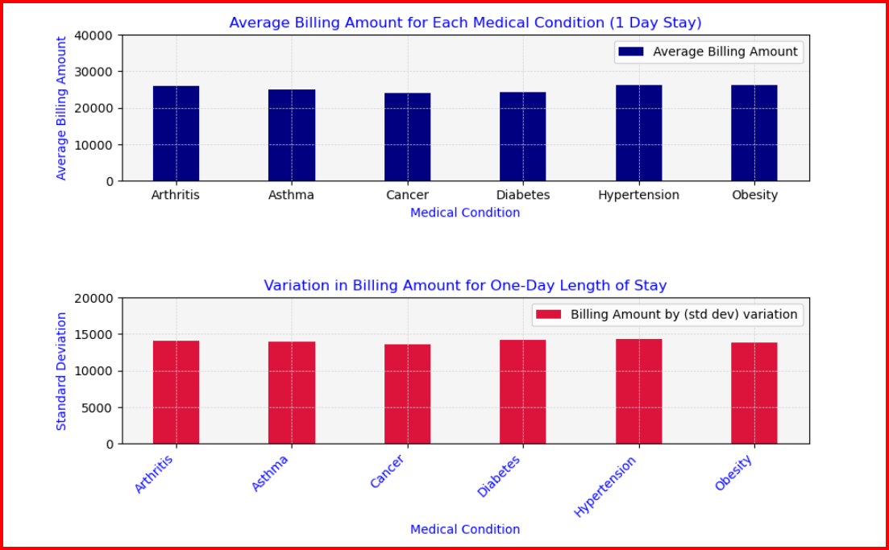

Slide 15
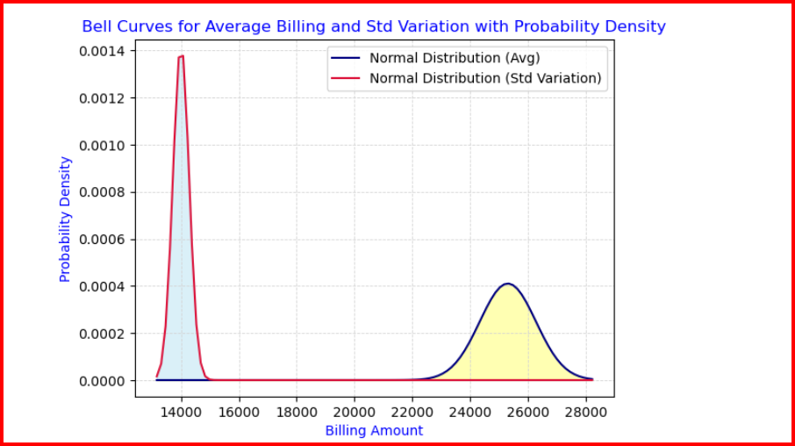

Slide 16
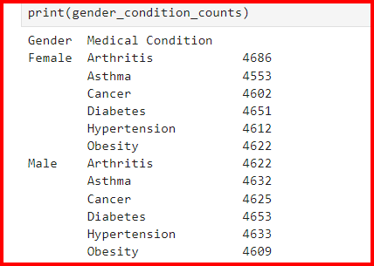

Slide 17
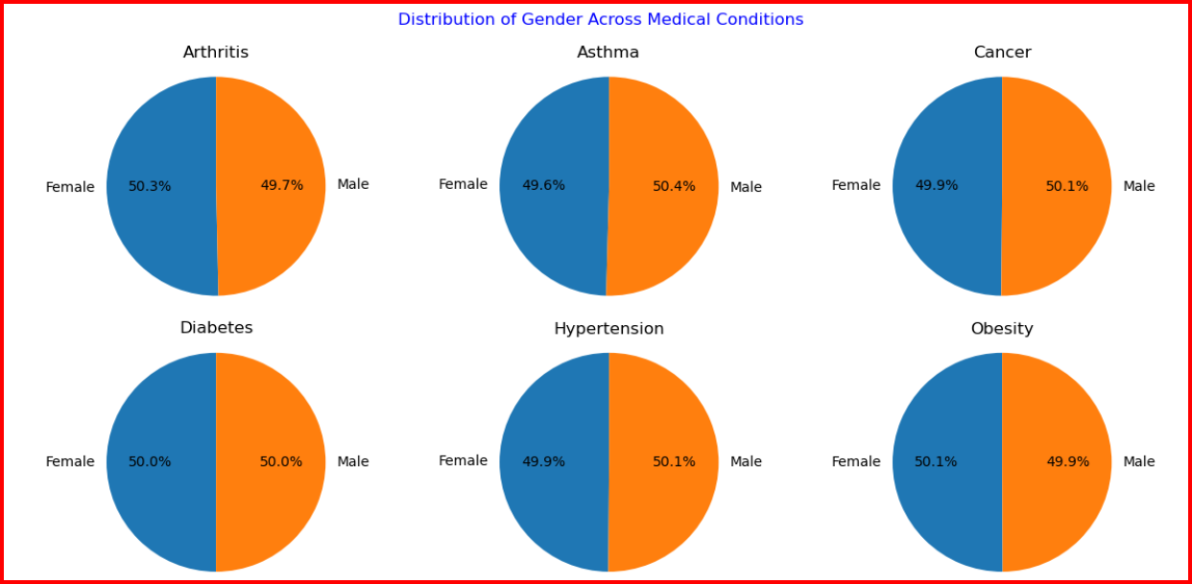

Slide 18
Conclusions:
One-day hospital stay for managing hypertension had the highest billing cost in this data-set.
The higher probability density peak and wider spread in standard deviation plot suggested more variability in terms of individual billing amounts. Also, indicative of potential outliers, (high/low billing amounts) contributing to the variability
The prevalence of medical conditions amongst the females was slightly more for arthritis & obesity. Males were slightly more prone for asthma, cancer & hypertension. Both Males & females were equally prone for diabetes.
Thank you: Team members, Richard, & Deborah, and all of you, for your Support!

Slide 19
Team Member: LaQuita Palmer
Data Origin: We have analyzed data from the csv entitled Unlocking Healthcare Trends, authored by Muhammad Furqan.
Focus: In this dataset, I have grouped the data according to 2 different criteria: By Insurance Provider, Medical Condition, and Billing Amount, and by Insurance Provider and the number of admissions for each Provider.
Visualizations: From these groupbys I have visualized the following: 1) Average Billing Amount by Insurance Provider and Medical Condition 2) Most admitted Medical Condition.
I used the following visualizations: Bar Chart with Subplots and Pie Chart.
Conclusions:
Conclusion1: The highest Provider and Billing Amount: BlueCross @ $26100.78 and Cigna @ $26116.99 (Obesity)
Conclusion2:: The most admitted condition: Arthritis and Diabetes both at 16.8%

Slide 20



Slide 21
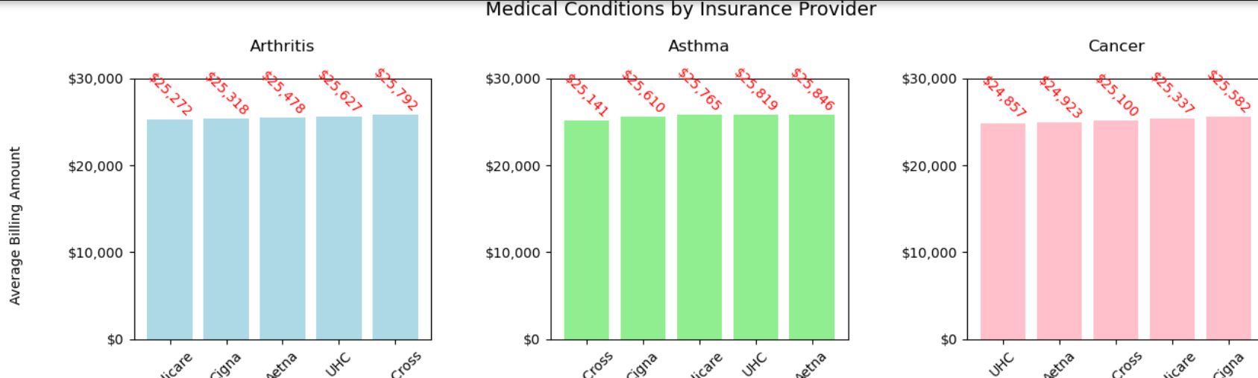

Slide 22
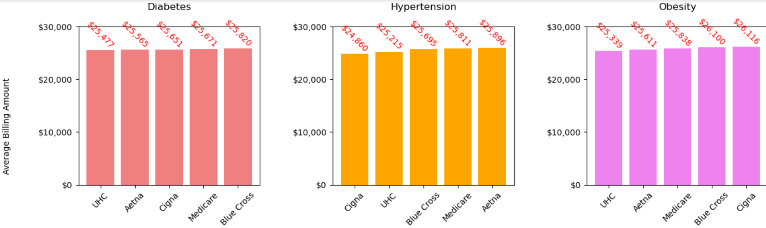

Slide 23
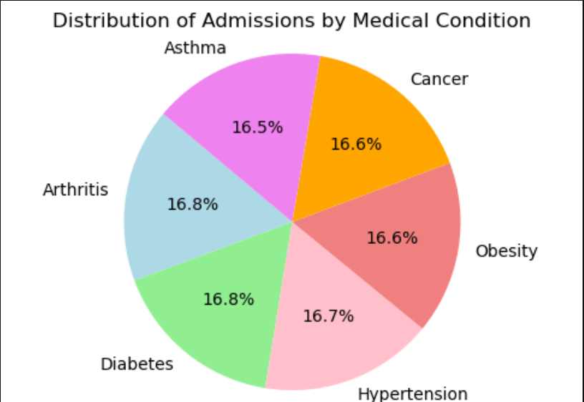

Slide 24
Derek Hill
Questions:
What are the admission trends over time?
What is the age distribution among medical conditions?
Conclusions:
There is a steady increase into 2020, but declines to regular admission numbers later on.
There is obvious spikes of conditions among patients 20 and older(Older age is correlated with decreased health usually)

Slide 25

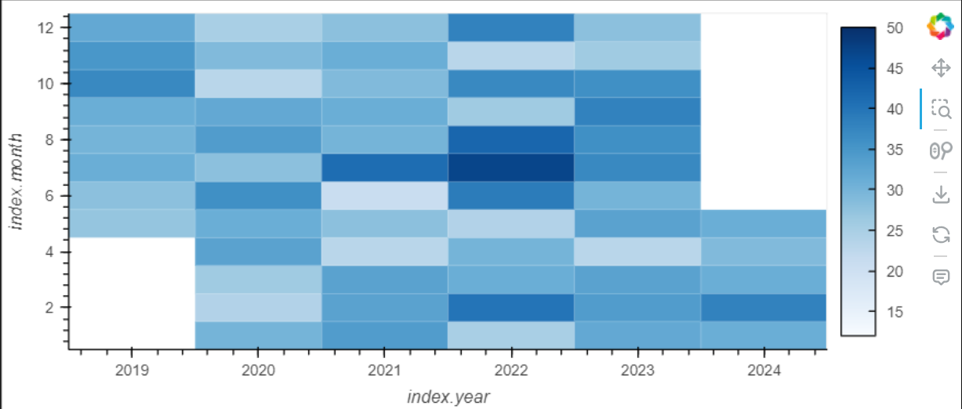

Slide 26

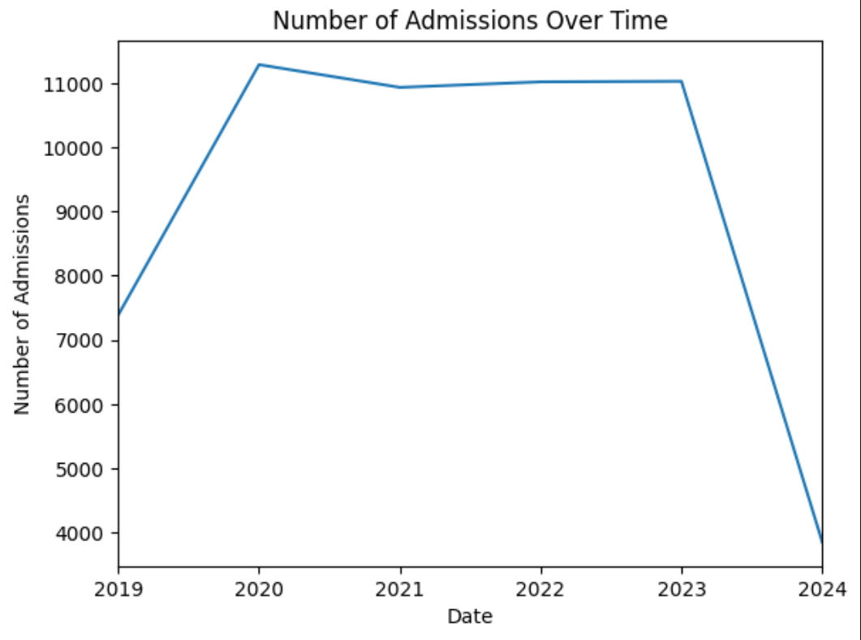

Slide 27

